Slide 1

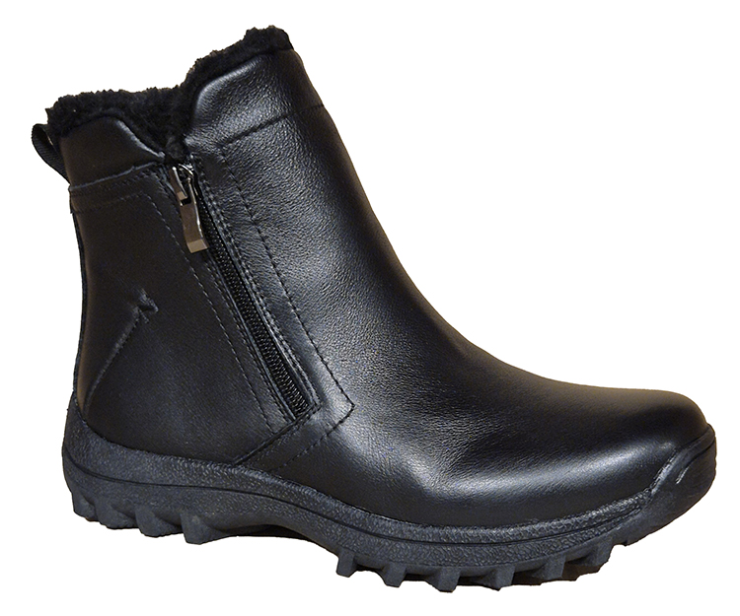
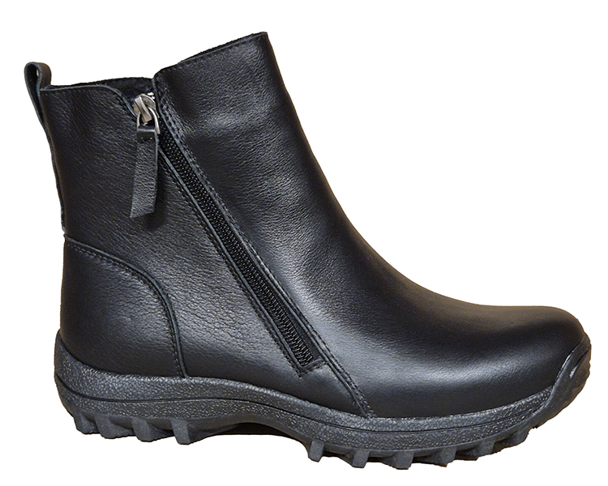

AUTUMN/WINTER 2026
Norholt
05562225 leather
Plumstead
05562224 leather

Slide 2
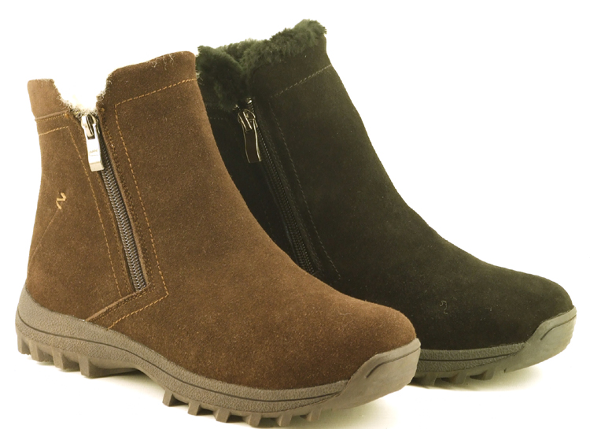
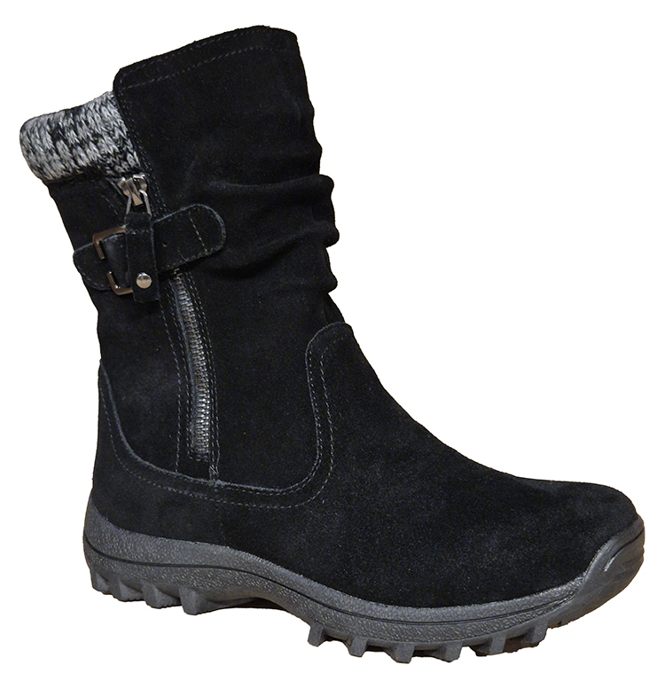

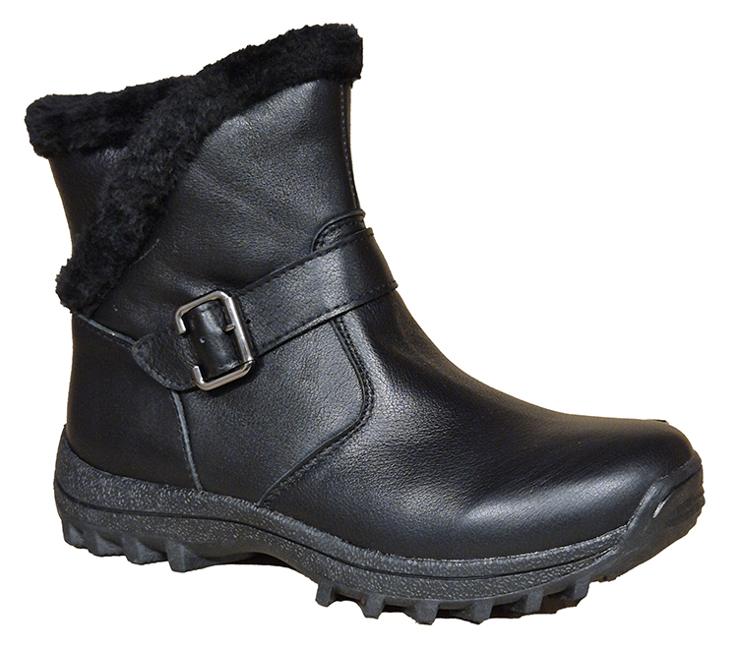
Holloway
05562228 suede
Osterley
05562227 suede
Redbridge
05562226 leather

Slide 3
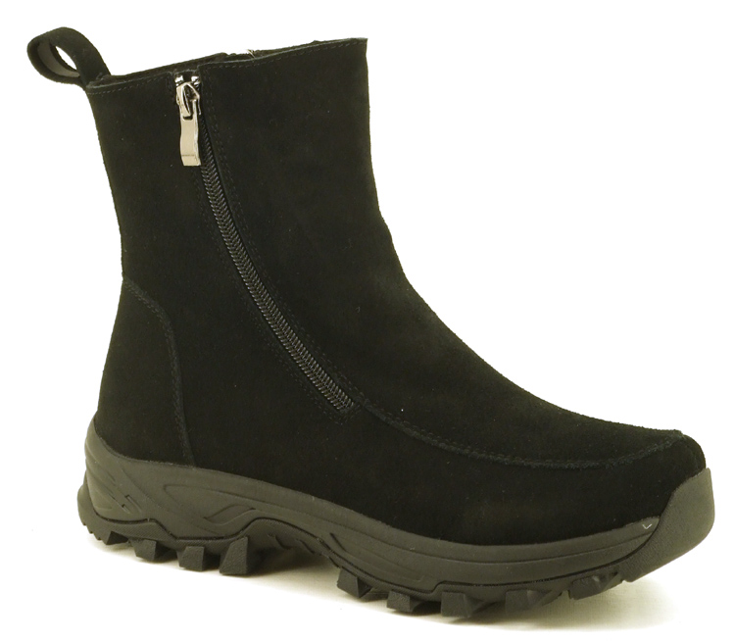
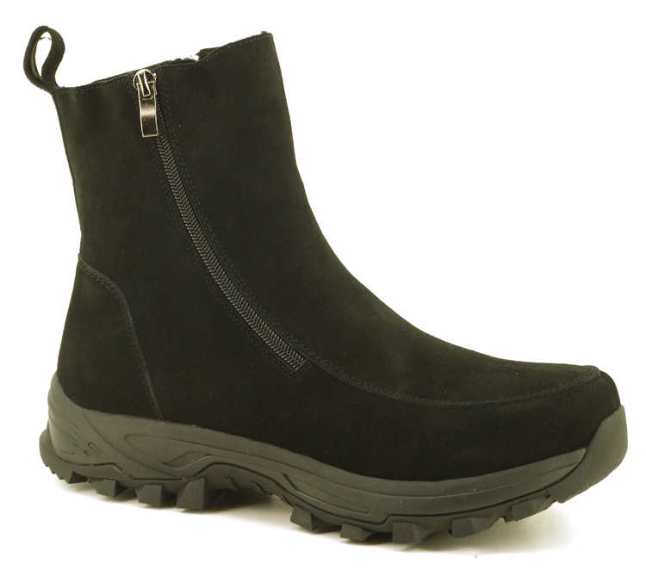
UTFÄLLBARA BRODDAR
Leamouth brodd suede
05562229 lady
05562230 man

Slide 4
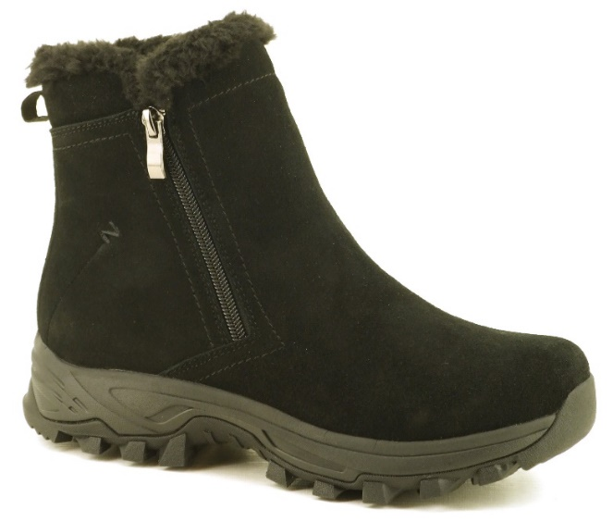
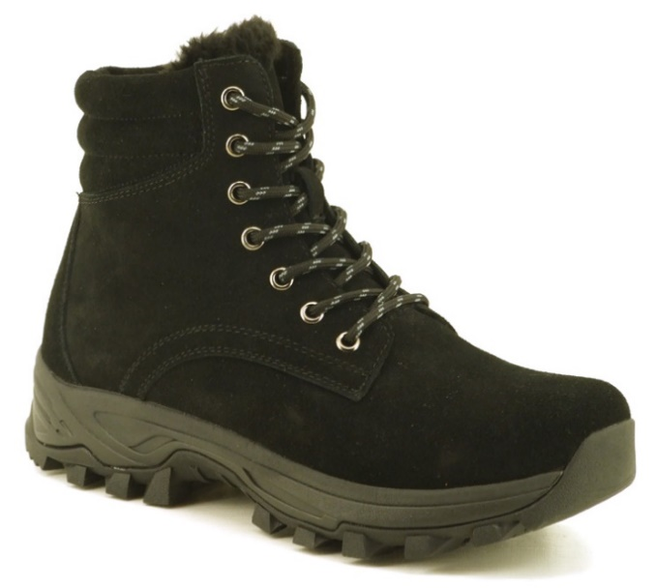
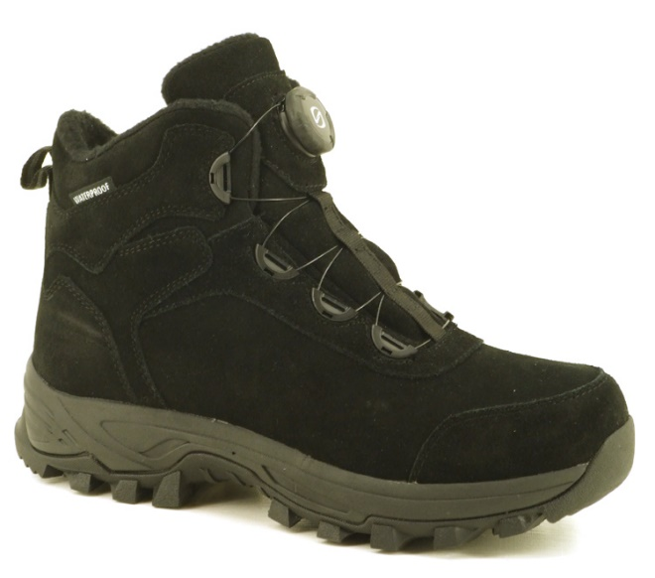
UTFÄLLBARA BRODDAR
Bower brodd
05562234 suede
Lampton brodd
05562231 suede
Cross brodd suede
05562232 Lady
05562233 Man

Slide 5
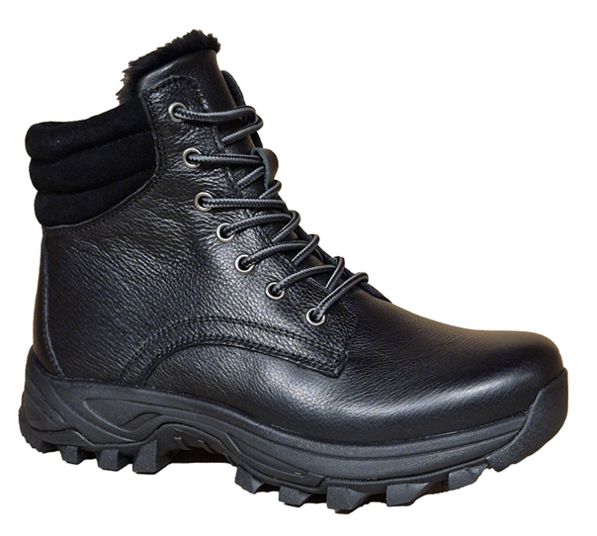
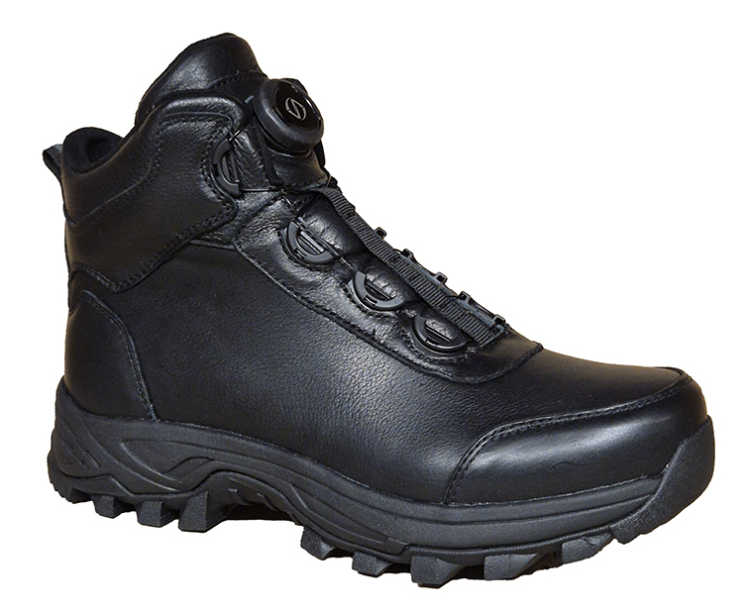
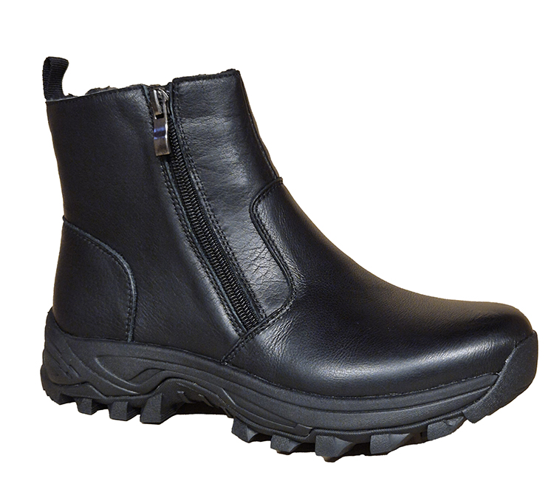
UTFÄLLBARA BRODDAR
Halton brodd
05562235 leather
Bromley brodd leather
05562237 dam
05562238 herr
Marylee Brodd
05562236 leather

Slide 6
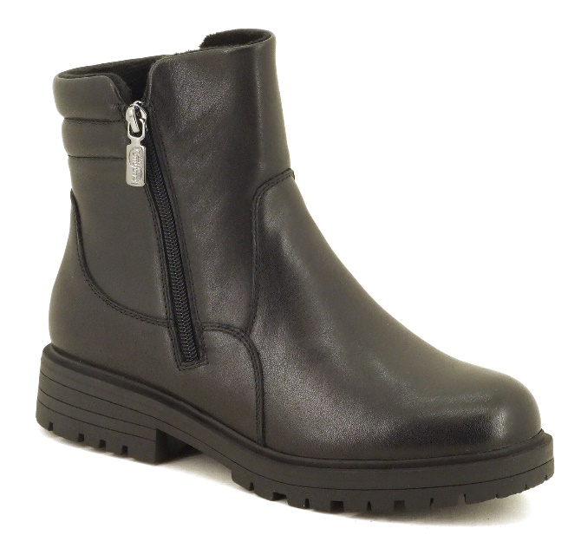
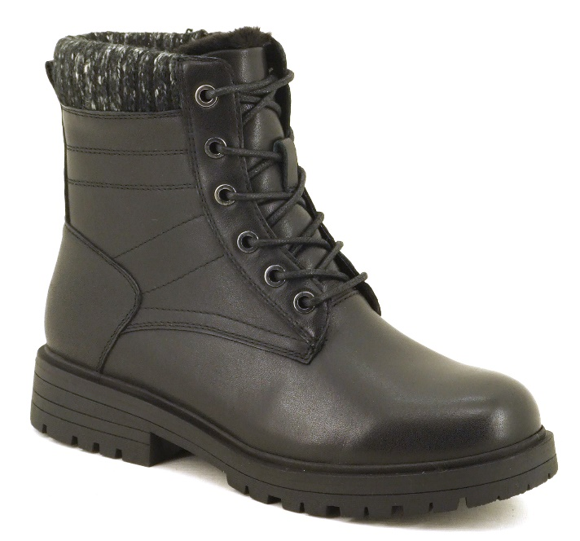
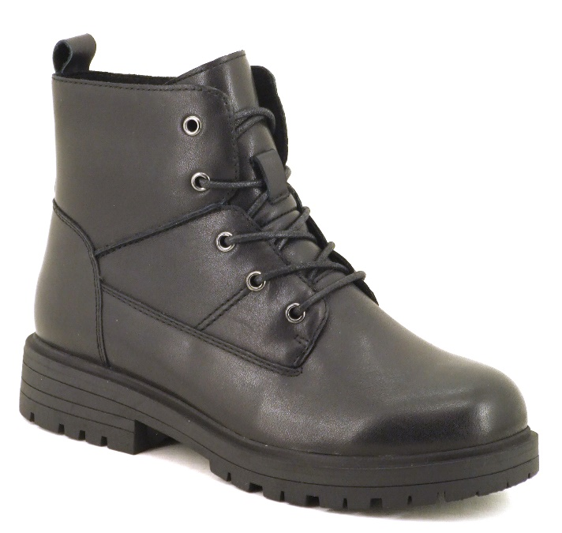
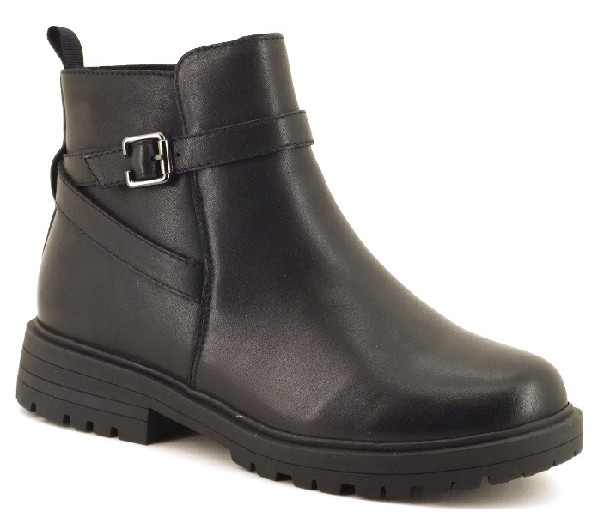
UTFÄLLBARA BRODDAR
Sunberry brodd
08562202 leather
Belgravia brodd
08562203 leather
Fortis brodd
08562206 leather
Grahame brodd
08562210 leather

Slide 7
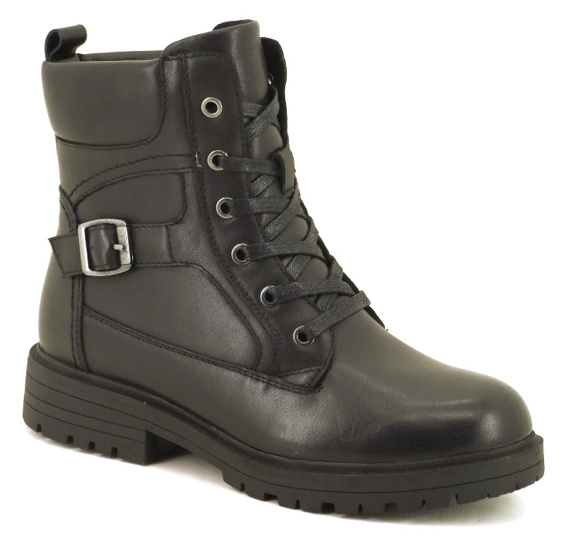
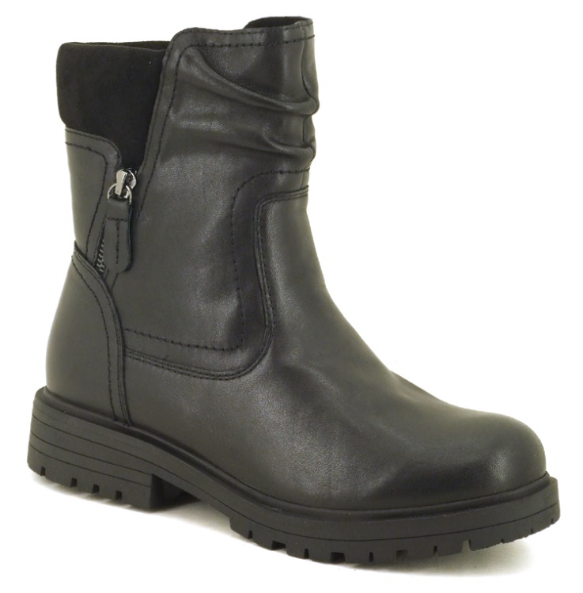
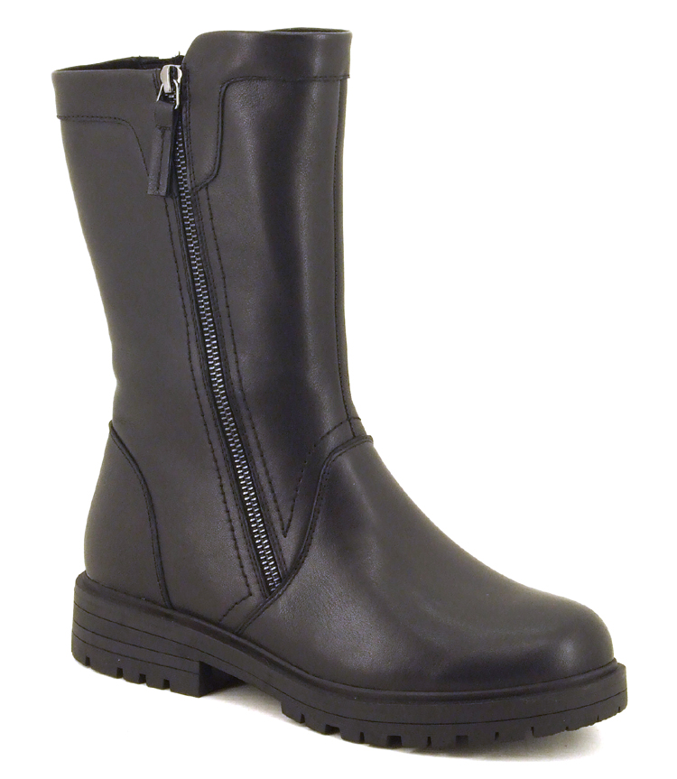
UTFÄLLBARA BRODDAR
Wallingtong brodd
08520204 leather
Norwood brodd
08562211 leather
Millbank brodd
08562208 leather

Slide 8
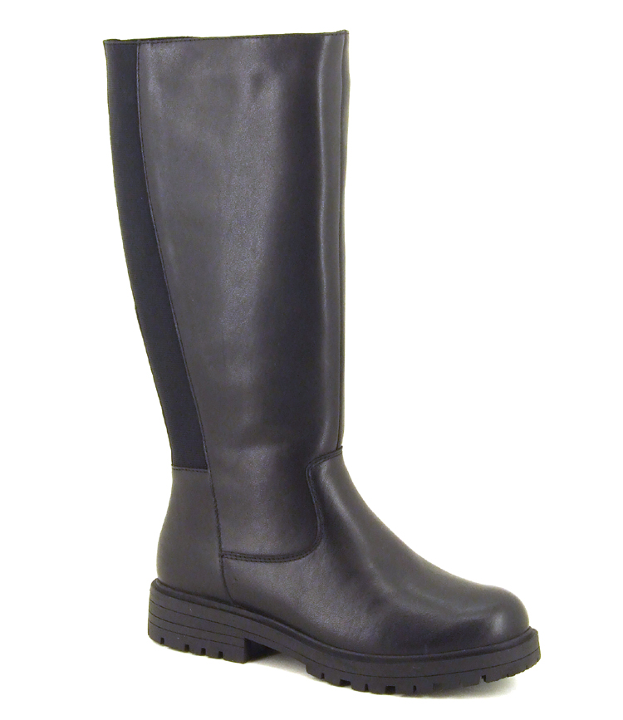
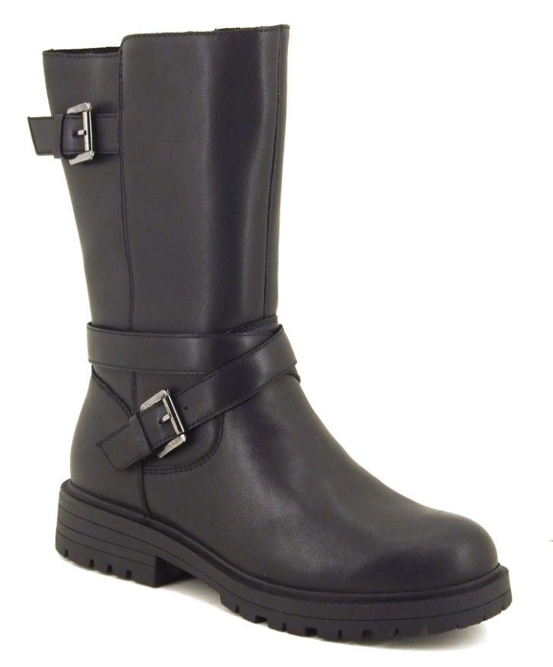
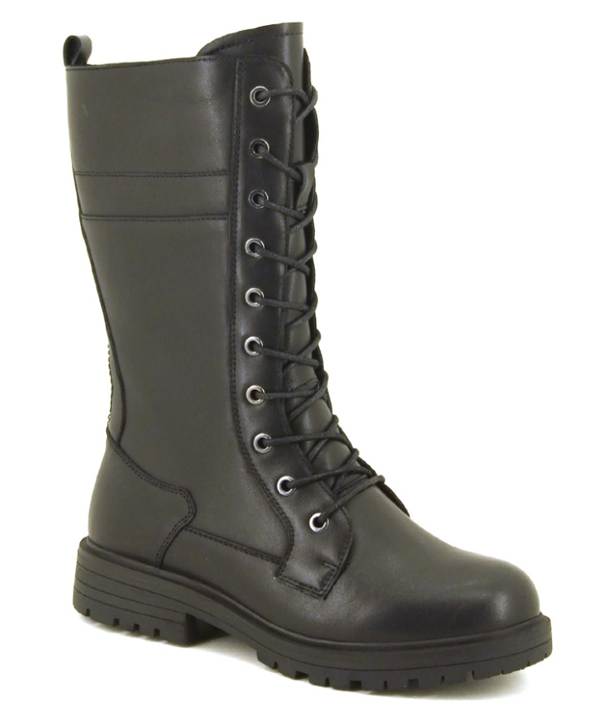
UTFÄLLBARA BRODDAR
Brentford brodd
08562209 leather
Wapping brodd
08562207 leather
Shadwell brodd
08562205 leather

Slide 9
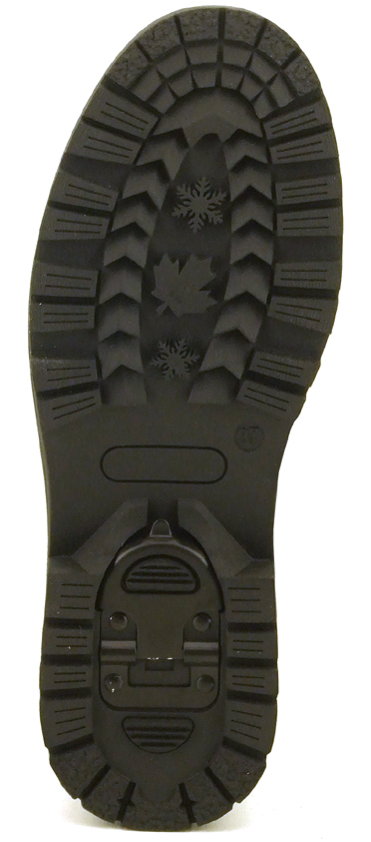
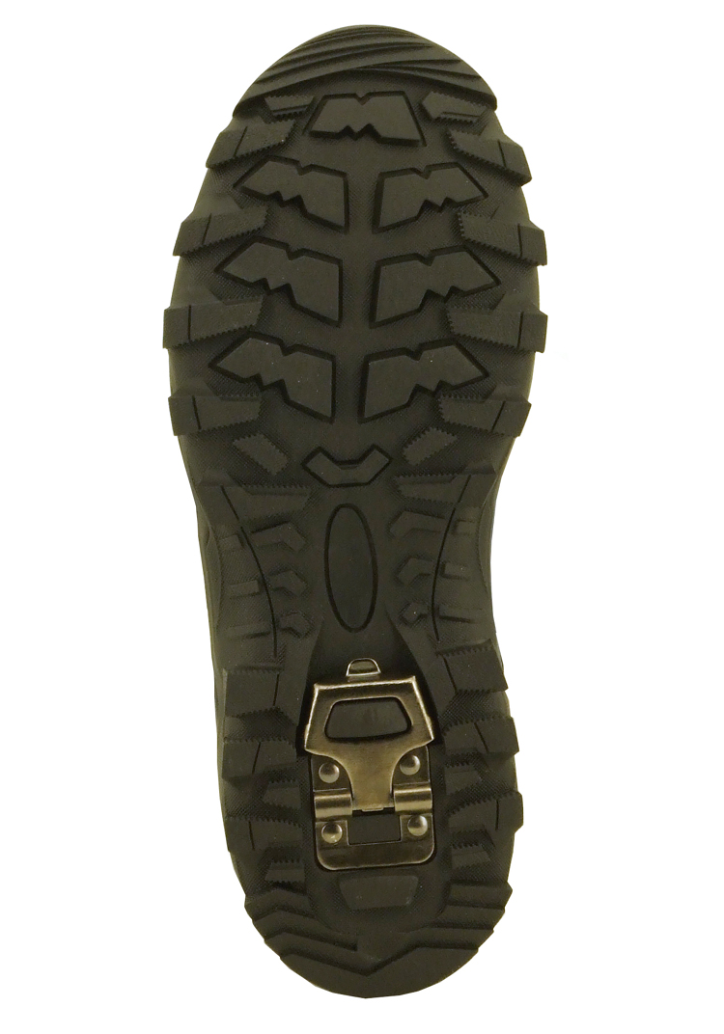
BRODDSULOR
Broddsula för skinnkängorna
Broddsula för mockakängorna
dam och herr

